Slide 1

FOOD OF INDONESIA

Slide 2
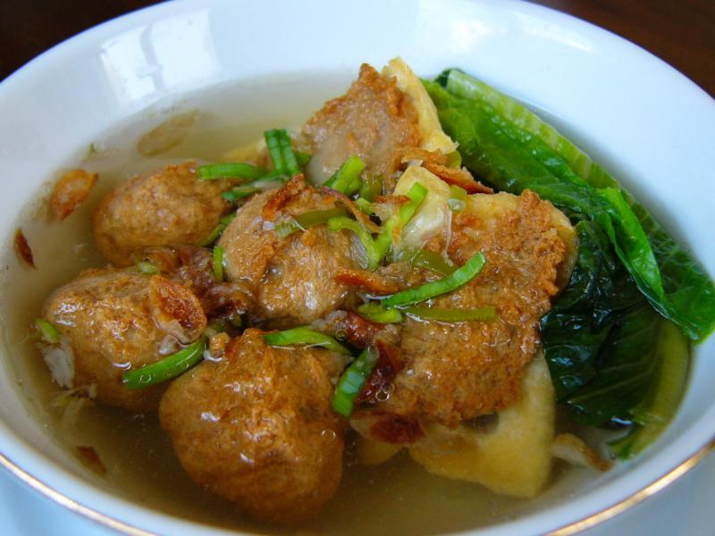
Bakso
The meatballs
1 kilo of very fine minced meat (preferably beef)
2 eggs
300 grams of tapioca-flour
4-8 cloves of garlic
1 red onion
1 teaspoon of white pepper
2 teaspoons of salt
The soup
1 liter chicken bouillon
3-7 cloves of garlic
1 red onion
salt and pepper
Bakso is a famous food in Indonesia which can be bought almost everywhere and in muslim parts of Indonesia it can only be sold at night. Bakso is pretty much a meatball soup with vegetables and chilli sauce.

Slide 3
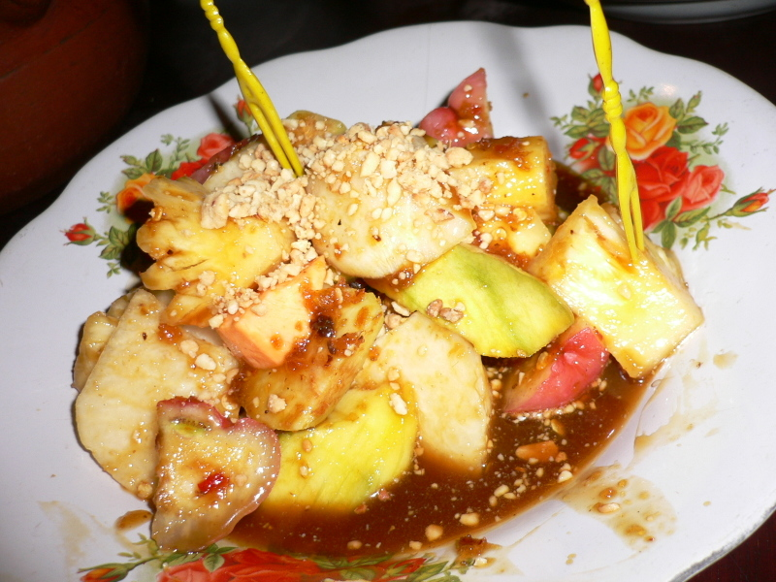
Rujak
Rujak is a known as a spicy fruit salad and is the national salad of Indonesia. It is made with pineapple, green apples, bananas, cucumbers and is covered in chili powder, dark soy sauce, brown sugar and lime/lemon juice.
Ingredients
1 medium-sized can pineapple chunks
2 bananas, peeled and chopped
3 green apples, peeled and chopped
1 small cucumber, peeled and sliced
DRESSING:
1 teaspoon chili powder
1 Tablespoon dark soy sauce
½ cup dark brown sugar
2 Tablespoons lime (or lemon) juice
Procedure
Place all fruits and vegetables into a bowl and mix thoroughly.
In a separate bowl, combine dressing ingredients.
Pour the dressing over the fruits and vegetables. Chill before serving.

Slide 4
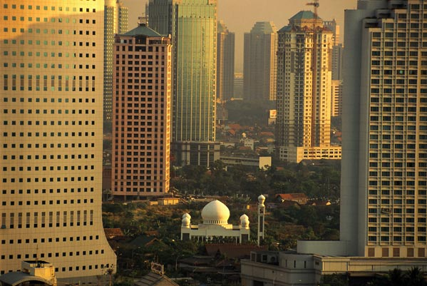
Food from Jakarta

Slide 5
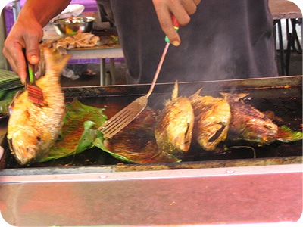
Ikan Bakar
Ikan bakar is pretty much just fish (or other types of seafood) grilled using charcoal and in english it means burnt fish. Usually this is marinated and can be wrapped in banana leaf or just have banana leaf in between the meat and the heat. This is usually cooked with fish, squid and sometimes stingray

Slide 6
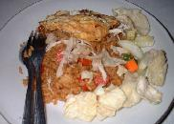
Nasi Goreng Mentang
Nasi Goreng Menteng dari Jakarta. Itu dari area menteng dari Jakarta.
Nasi Goreng Menteng dari Jakarta. Itu dari area menteng dari Jakarta. itu terbuat dari sosis telur dan kerupuk dan dilayani oleh pedagang kaki lima
Nasi Goreng menteng is from Jakarta. It is from the Menteng area of Jakarta. It is made with sausages, eggs and is served with crackers and it is sold by the street vendors.

Slide 7

Food from Sumatra

Slide 8
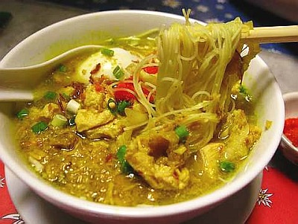
Soto Sumatra
Soto Sumatra is a traditional Sumatran soup that is made with coconut milk and spices and is usually served with chicken.
Ingredients
1kg Chicken - thigh or breast
1 Onion
2 tablespoons Ginger
4 cloves of garlic
2 small red chillies
Lemon grass
Galangal
1 teaspoon Turmeric
1 teaspoon Salt
2 teaspoons Coriander
2 teaspoons Palm sugar
1/4 teaspoon Pepper
1/2 litre of chicken stock
1 can of coconut cream
3 cups of water
1.5 tablespoons lemon juice

Slide 9
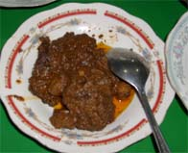
Beef Rendang
One traditional Sumatran dish is beef rendang because Sumatrans are known for making spicy food
satu hidangan tradisional Sumatra adalah karena sumatrans rendang daging sapi yang dikenal untuk membuat makanan pedas.
Ingredients:
1 tsp shrimp paste
1 kg rump steak
1 stalk lemon grass
5 candlenuts, Ground
1 tsp salt
1 tbsp sugar
1 tbsp soya sauce
1/2 cup thick coconut milk
8 tbsps oil
2 cm piece ginger
3 stalk lemon grass - sliced thinly
120gms grated coconut
4 slices galangal
2 tbsp curry power
120 gms shallots
4 red chillies
1 clove garlic

Slide 10

Food from Bali

Slide 11
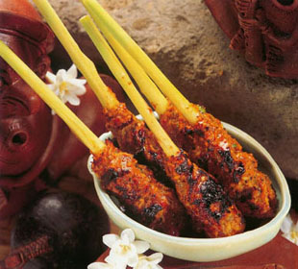
Sate Lilit
INGREDIENTS:
600 gr skinned boneless snapper fillet
1 cup freshly grated coconut or
1½ cups moistened desiccated coconut
½ cup seafood spice paste
5 fragrant lime leaves, chopped
1 tsp black peppercorns, finely crushed
1 tsp salt
3-5 bird's eye chilies, very finely chopped
2 tbsp palm sugar
Lemon grass or satay skewers
Sate lilit is a seafood sate. It is traditionally made with lemon grass as the skewer and coconut husks instead of charcoal. But it can still be made with wooden skewers and charcoal. It is usually made with fish and shrimp, that is fresh and it’s loved by the locals of Bali.

Slide 12
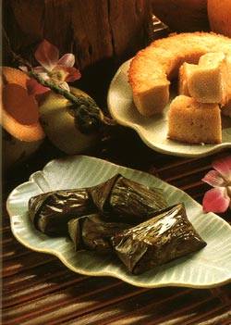
Kuih Pancong
INGREDIENTS:
2 cups freshly grated coconut, or
1½ cups desiccated coconut moistened with warm milk
1/3 cup glutinous rice flour
1/3 cup plain rice flour
¼ cup white sugar
½ tsp salt
Pancong cake is a coconut cake. It can be served with fruit such as jackfruit or have coconut milk poured on top of it. This is also a well known cake of Bali.

Slide 13
Bibliografi
http://www.virtualtourist.com/travel/Asia/Indonesia/Special_Capital_Region_of_Jakarta/Jakarta-1218371/Restaurants-Jakarta-Street_Food-BR-1.html
http://www.foodbycountry.com/Germany-to-Japan/Indonesia.html
http://inertz.org/wp-content/uploads/2008/02/indo_fruite_rojak.jpg
http://ananfeatures.files.wordpress.com/2009/06/bakso1.jpg
http://networkfood.files.wordpress.com/2009/06/soto-ayam.jpg

