Slide 1
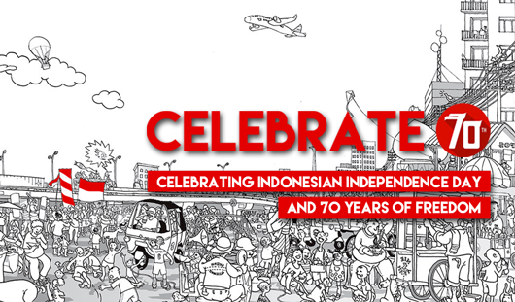

Slide 2


Slide 3

Independence Day of Indonesia is a day that marks when Indonesia was declared Independent from the Netherlands. This day is filled with festivities and celebrations. Despite the fact that Indonesia declared its independence from the Dutch Government on August 17, 1945, it wasn’t until 2005 that the Dutch accepted this date as the official date for Indonesia’s independence.

Slide 4
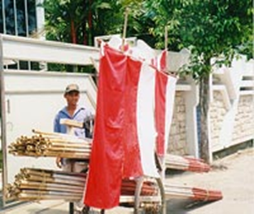

Slide 5
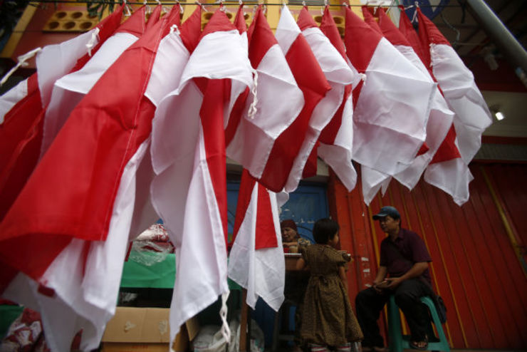
FLAGS FOR SALE. Indonesian flags are displayed for sale in the street, ahead of Indonesia's Independence Day celebrations in Banda Aceh, Indonesia.

Slide 6
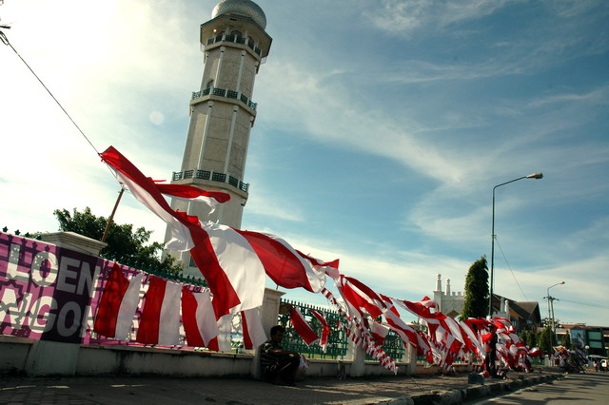
Preparations for the patriotic celebrations begin weeks before the 17th of August. High-rise office buildings around town sprout large banners or lighted designs, fences around the presidential palace and many government offices are draped in red and white bunting.

Slide 7
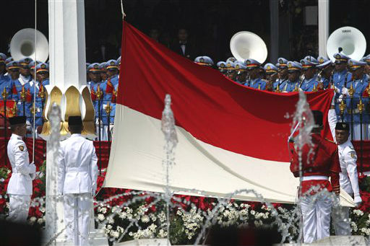
Flag bearers hoist Indonesian national Red-White flag during a ceremony commemorating the country's Independence Day at Merdeka Palace in Jakarta, Indonesia.

Slide 8
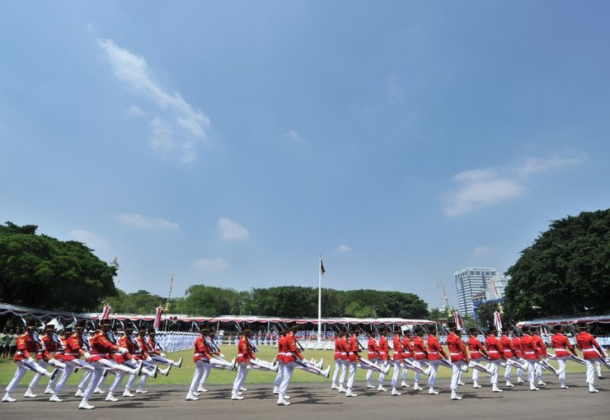
INDEPENDENCE PARADE. Presidential honour guards take part in a ceremony marking the 69th Indonesian Independence day in Jakarta on August 17, 2014.

Slide 9
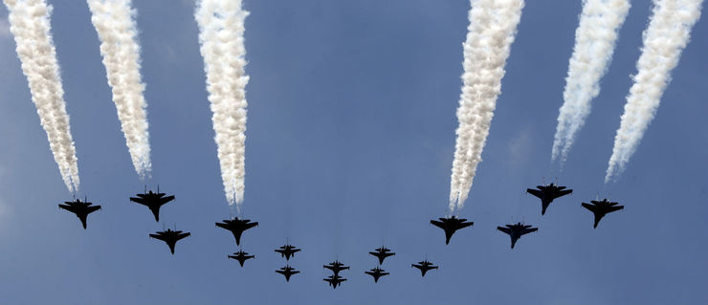
AIR FORCE. Indonesian Air Force's fighter aircraft fly over the parade ground during the 69th Independence Day Anniversary at the State Palace in Jakarta on August 17, 2014.

Slide 10
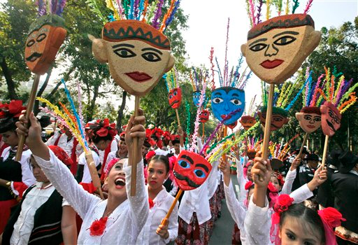

Slide 11
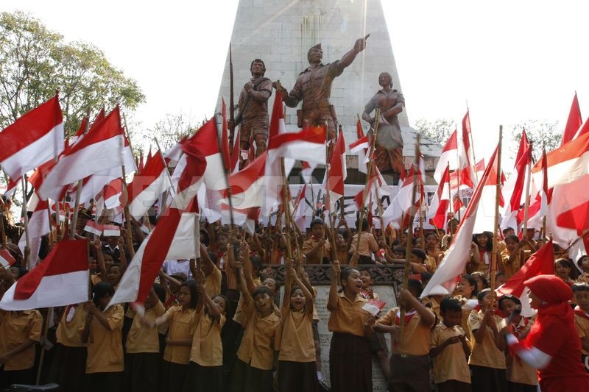
Students hold Indonesian national flags to celebrate Indonesian Independence Day in Solo. August 17th marks the anniversary of the country's independence from former colonial power The Netherlands.

Slide 12
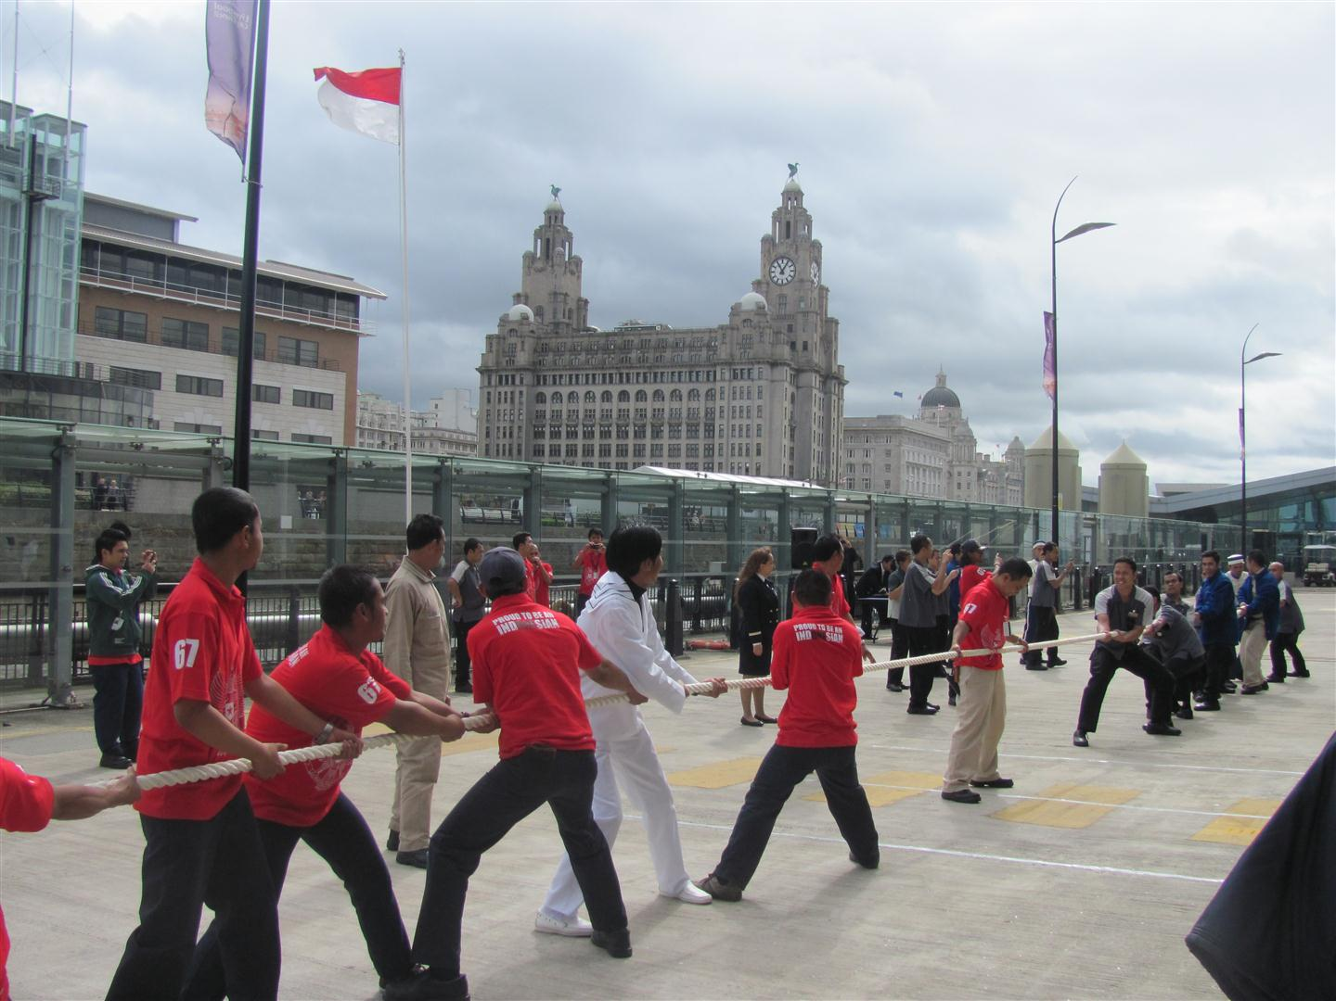

Slide 13
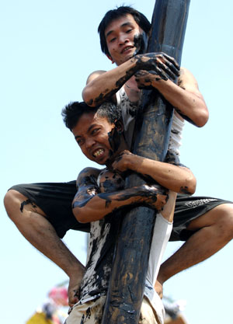
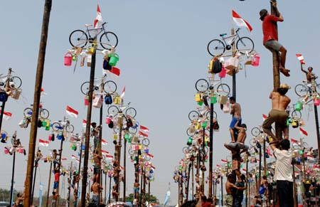
PANJAT PINANG. Contestants help one another to climb greasy poles to reach prizes hung at the top during the celebrations of Indonesia's Independence Day in Jakarta Aug. 17.

Slide 14
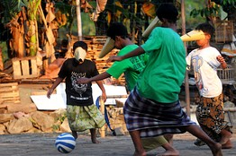
Football Cone
What makes this competition different from a regular football match is that each player is required to cover his or her face with a cone, making it far harder to see the ball. A bit like watching someone stumble in the dark, this contest is always amusing to watch because it can take participants quite a lot of time and effort to kick the ball and reach the goal.

Slide 15
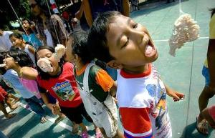
Kerupuk Eating Competition
Lomba makan kerupuk, or the cracker eating contest, is one of the most popular Independence Day competitions.

Slide 16
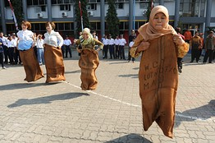
Indonesian women participate in a sack race during celebrations to commemorate the Indonesia’s Independence Day in Surabaya.

Slide 17
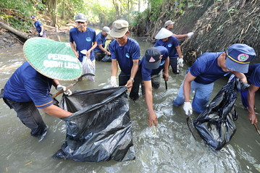
In many neighbourhoods, people will perform communal work known as ‘gotong-royong’, which often involves gathering to clean up their neighbourhood together.

