Slide 1


Sister Schools in Bali
Adopted by Aveley Primary School

Slide 2
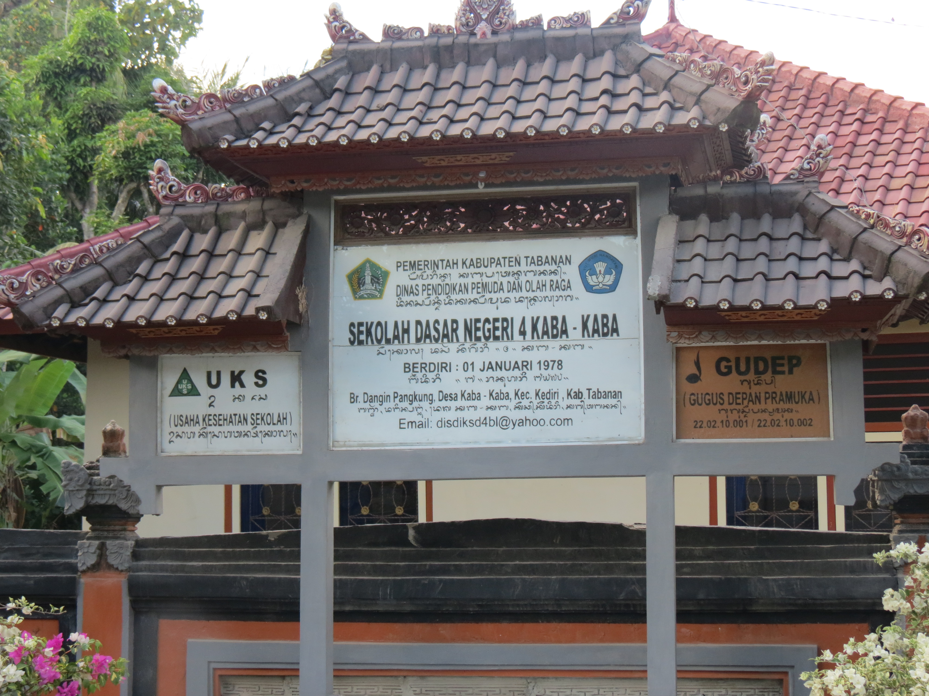
History
Aveley Primary School embarked on adopting the first school in Bali in 2014.

Slide 3
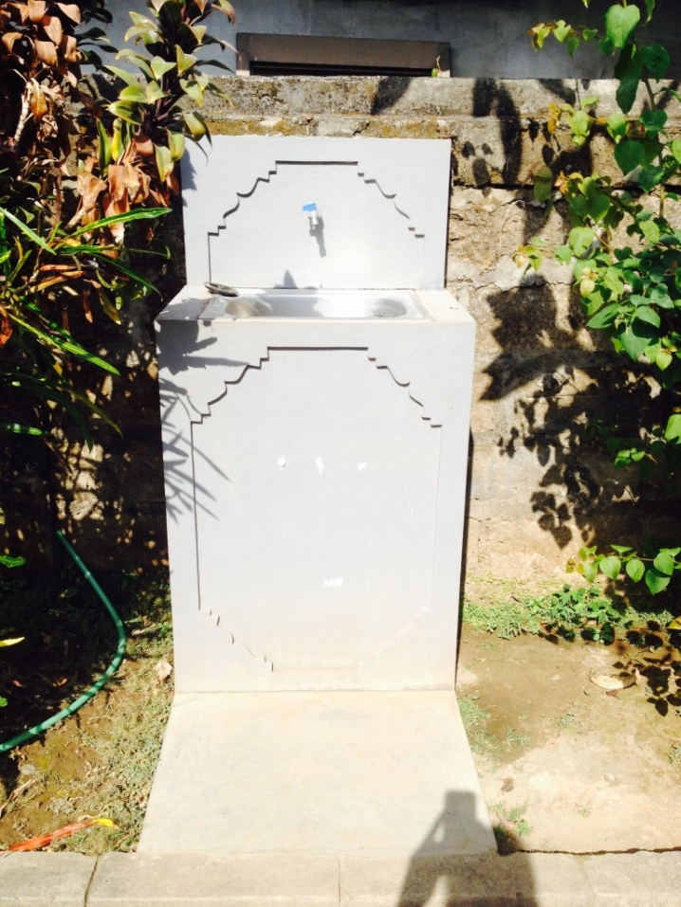
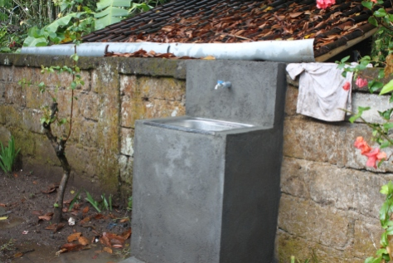
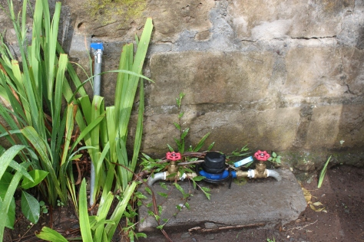
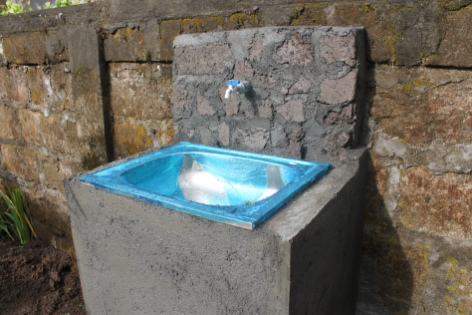
Clean Water Project
Our first sister school did not have any running water, so our first goal was to help them.
First Fund Raising 2014

Slide 4
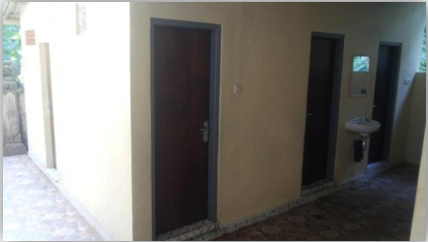
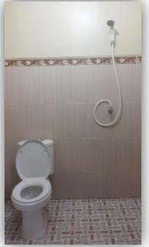
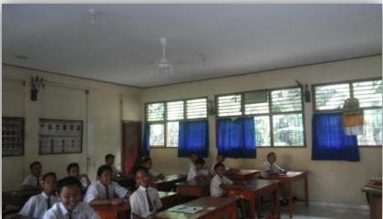
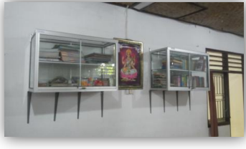
PROJECTS: Toilet/Bookshelves/Fans
We helped to fund these

Slide 5
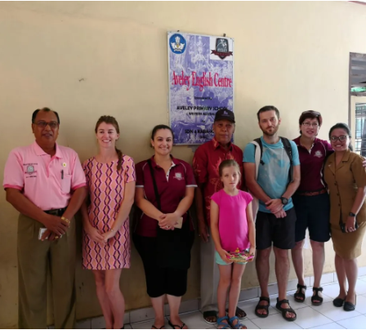
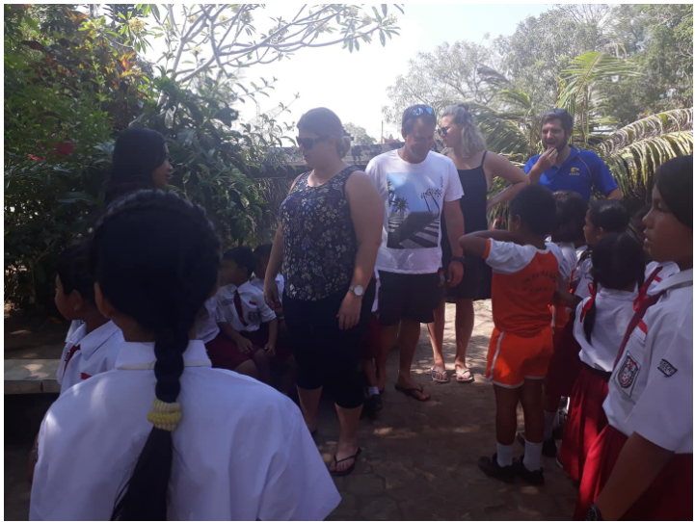
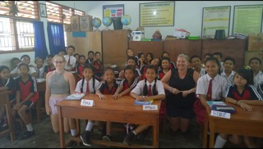
Visitors to Sister Schools
Staff visit
Staff visit
Mrs Hewitt’s visit

Slide 6
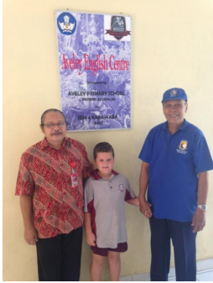
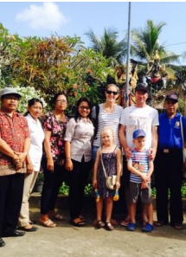
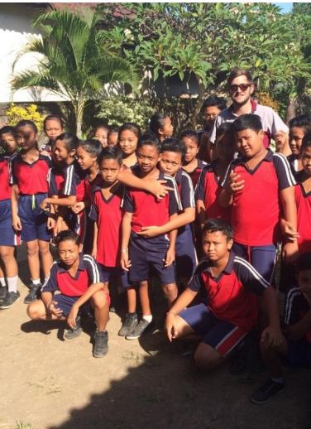
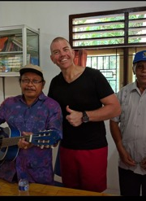
Visitors to Sister Schools
Mclaren family
Freestone family
Mr harvie
Mr spencer

Slide 7

During the Covid Pandemic the schools were all closed, and no one was allowed to enter for 2 years. Hence, the buildings were neglected and fell into disrepair.

Slide 8
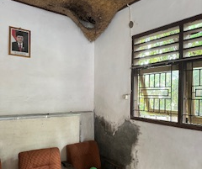
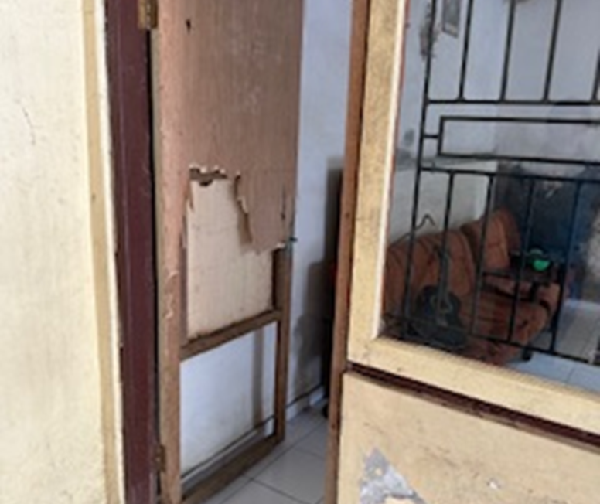
Aveley English Centre in SD4 Kaba-Kaba
In 2024, it has fallen to disrepair

Slide 9
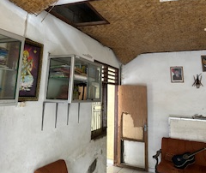
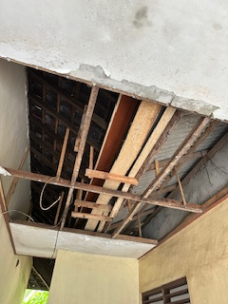
The current ceiling, door and wall.

Slide 10
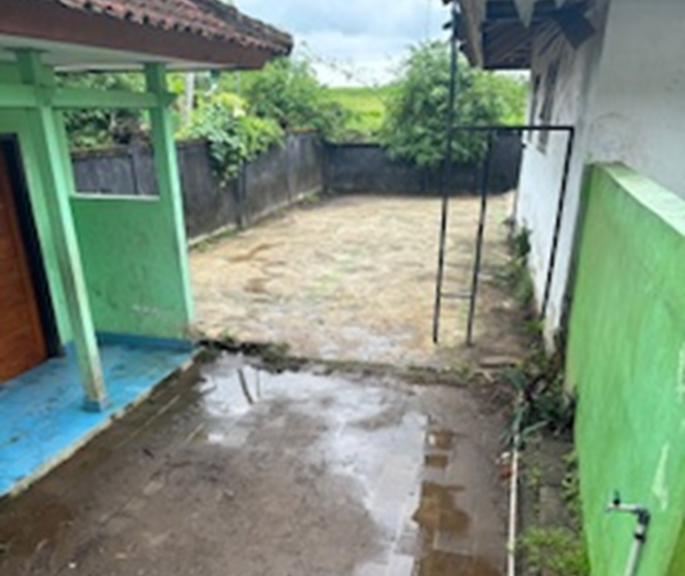
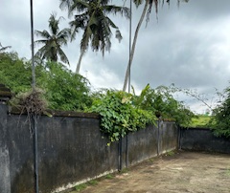
The badminton court and walkway in SD Cepaka in 2024

Slide 11
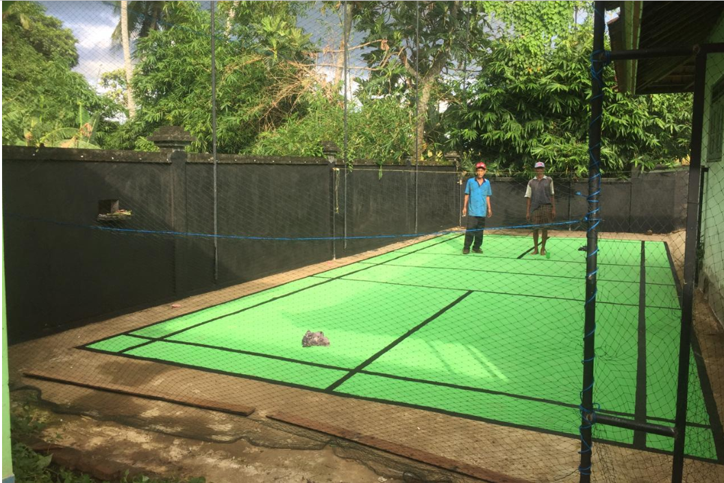
Badminton Court at SD CEPAKA
This was what it looked like pre-covid. We can help them to repair it to look like this again

Slide 12

28 March 2024
(Thursday)
(Last day of Term 1)

Slide 13

Thank you

